Slide 1
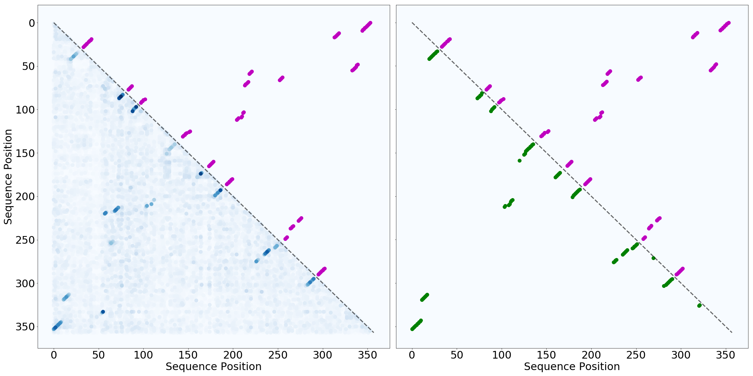
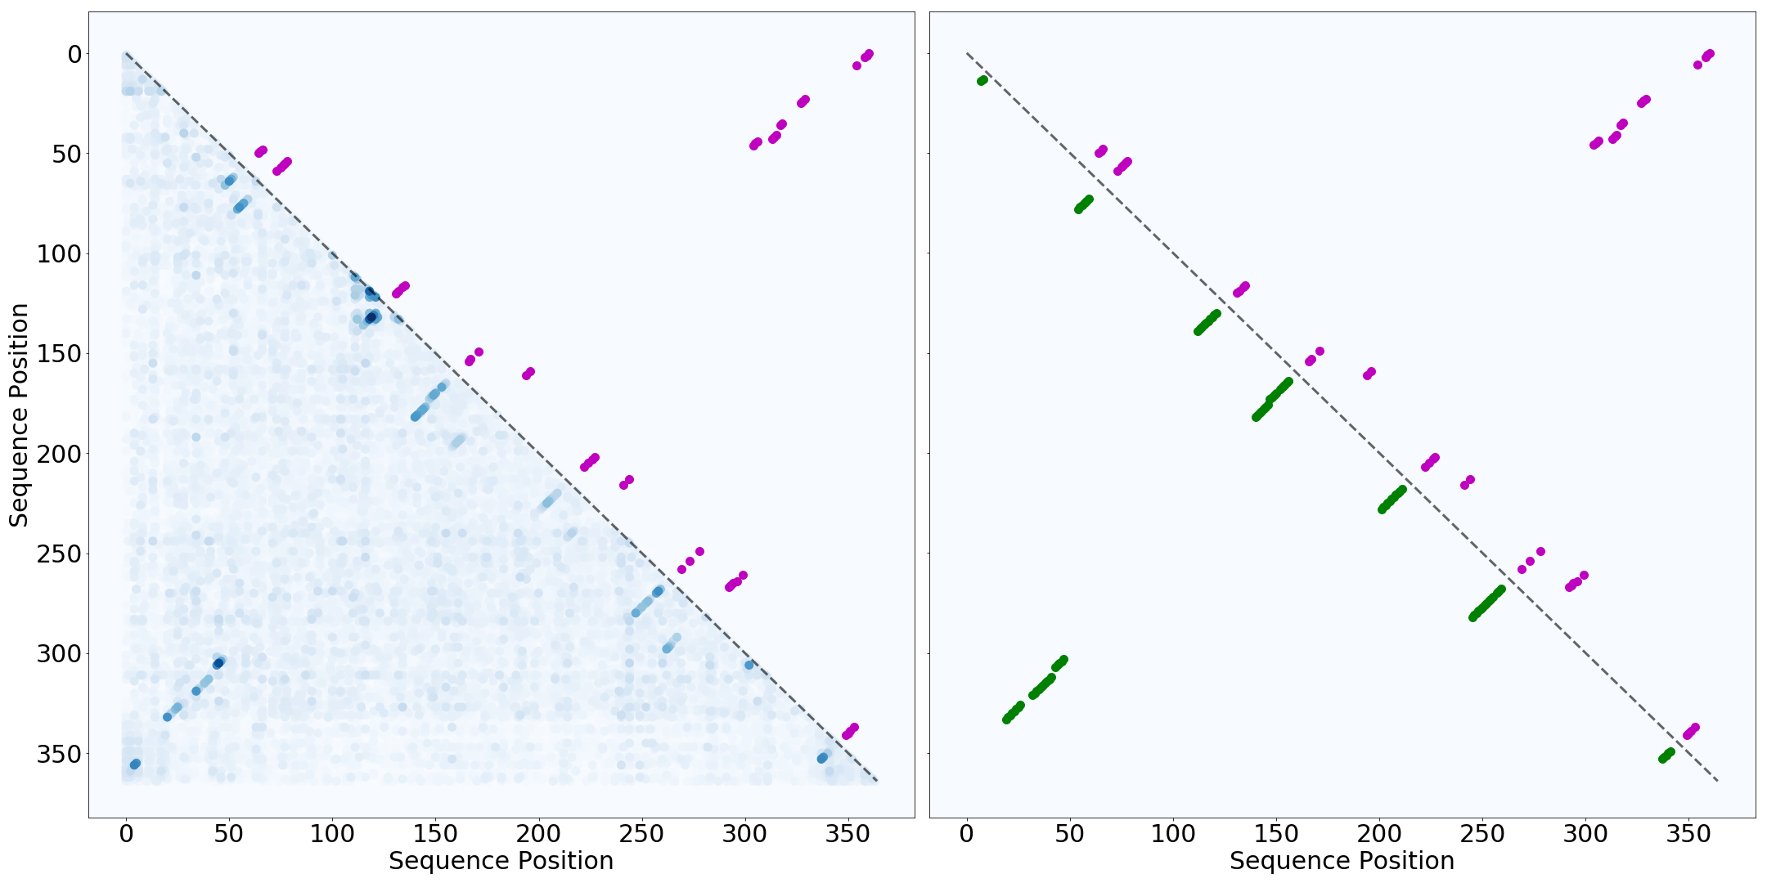
C
Bacterial Rnase P Class A – RF00010
P₂^{A}
P₁^{A}
P₂^{A}
Pseudoknot annotation
P₁^{A}
D
Transfer-messenger RNA – RF00023
High SoM score
P₁^{B}
P₂^{B}
Low SoM score
P₃^{B}
P₄^{B}
Figure 6 continued: comparing the SoM scores of the trained MLPs with WC annotations and Infernal SS predictions for (C) Bacterial RNase P and (D) transfer-messenger RNA. Plots on the left show the SoM scores (blue) compared against WC annnotations (purple), and plots on the right show Infernal’s SS prediction (green) compared to WC annotations. The WC annotations do contain the known pseudoknotted base pairs. Grey boxes are drawn around the pseudoknots with labels corresponding to the colored annotations in A and B. Infernal cannot model pseudoknots, and thus it doesn’t have points in the grey boxes. The MLP does learn the pseudo knotted base pairs of both families and shows high SoM scores for the pseudo knotted base pairs that are found in the WC annotations.

